Slide 1
Context-modular memory networks support high-capacity, flexible, and robust associative memories
William F. Podlaski, Everton J. Agnes, and Tim P. Vogels
Presented by Deying Song

Slide 2
Highlights
Several types of contextual modulation for associative memory networks that greatly increase their performance
Context inactivates specific neurons and connections, which modulates the effective connectivity of the network
How gating and inhibition contribute to memory process
How memory access dynamically changes over time
How context representations may interact with and control memory process

Slide 3
Introduction
Effects of context on memory acquisition and retrieval
Associative memory: abstract recurrent networks, cell assembly, memory stored as attractors
Improved models come with caveats
Context dependence may control memory expression and search
Context-modular memory networks

Slide 4
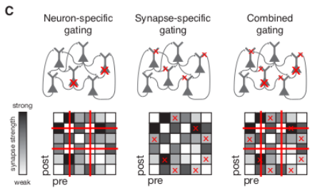
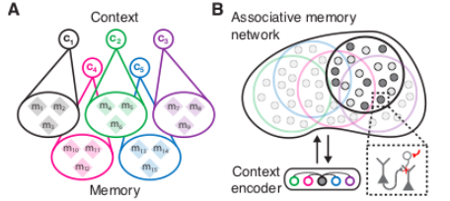
Schematic of the context-modular memory network
Neuron-specific gating: each context may define a corresponding subset of available neurons; Synapse-specific gating: each context define a subset of available synaptic inputs per neuron
Context is controlled by an external context-encoding network, such that one context is active at a time and memories outside of the active context remain dormant.

Slide 5
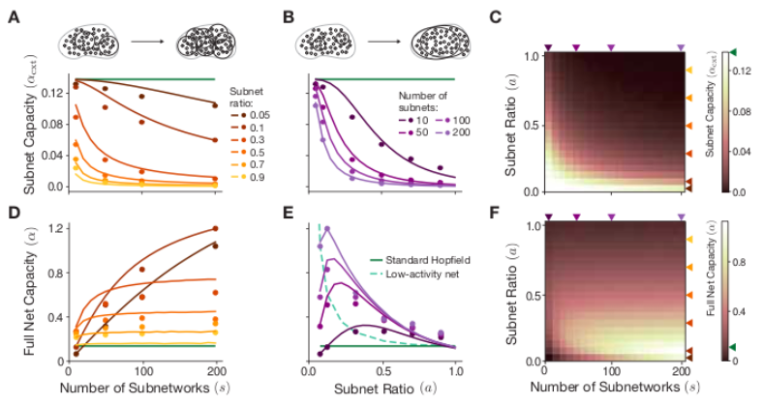
Neuron-specific gating improves memory capacity
A: for fixed subnetwork ratio
B: for fixed number of subnets
Lines: mean-field capacity estimation
Dots: numerical simulations

Slide 6
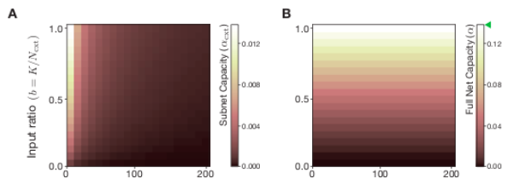
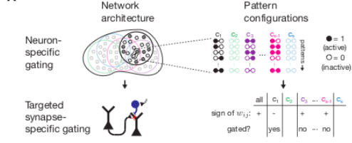
Random synapse-specific gating proves ineffective
While synapse-specific gating does enable contextual grouping, the number of stable memories is restricted by the Hopfield limit.
TaSS (targeted synapse-specific) gating
If there is a mismatch between the sign of the synaptic weight serving to stabilize all memories versus serving to stabilize memories belonging to a specific context, then this synapse is turned off for this context

Slide 7
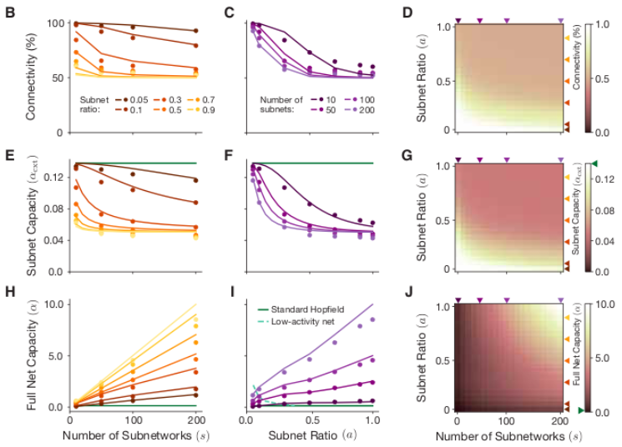
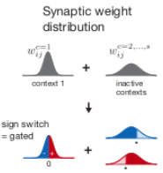
TaSS gating further enhances memory capacity
TaSS gating bears a resemblance to networks with binary synaptic weights
When enough “noise” has been added to the weight matrix, each element will have the desired sign approximately half of the time.

Slide 8
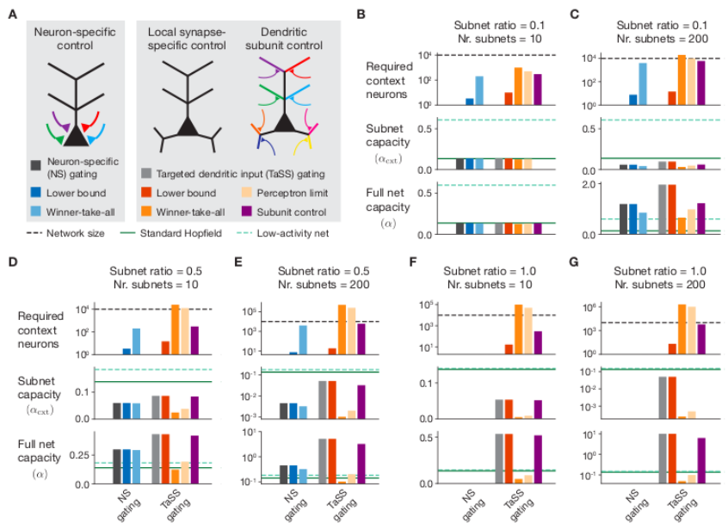
Complexity of contextual gating schemes
Implementing synapse-specific gating with full and independent control of each synapse is likely both ineffective and infeasible
cortical pyramidal cells
If synapses are distributed across these different subunits, it is plausible that synapse-specific gating can be controlled with on the order of 30 contextual synapses, with one on each branch.

Slide 9
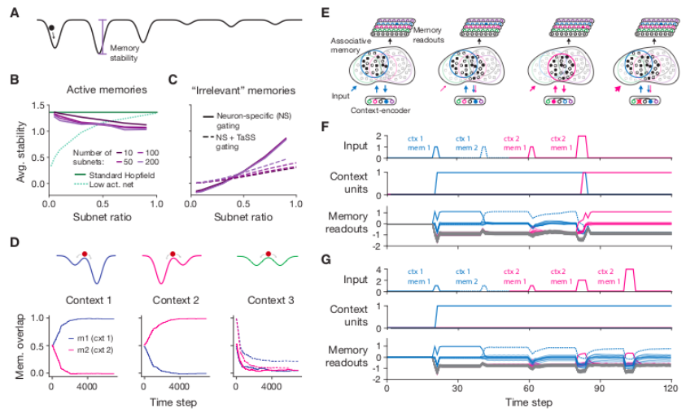
Memory stability is modulated by context
C: for large subnetwork ratios, TaSS gating improves performance by making irrelevant patterns less stable.
E: the loop keeps the current context and memory active, and prevents other areas of the network from being activated.

Slide 10
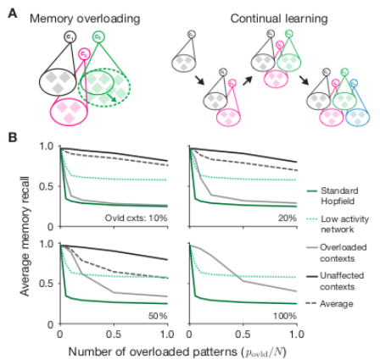
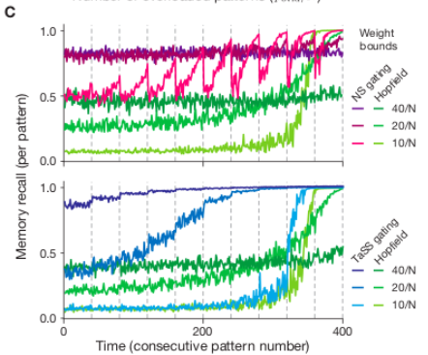
Memory overloading and continual learning
Despite the improved robustness to memory overloading, recall performance still declines as more memories are stored

Slide 11
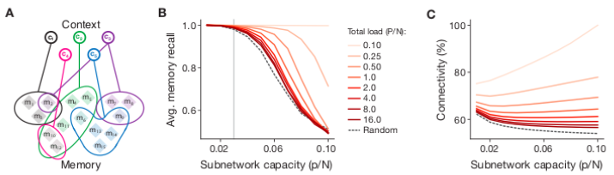
Arbitrary and shared context allocation
TaSS gating can be used to impose any activity pattern as a stable attractor independent of the weight matrix – i.e., groups of memories are stored in the TaSS gating structure.
Synaptic weights can be corrupted substantially without affecting performance, as long as the synapse-specific gating structure remains intact.

Slide 12
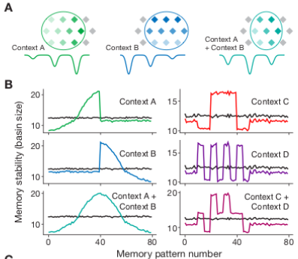
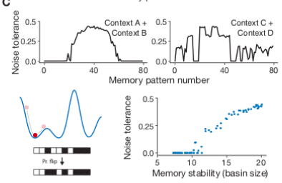
Distributions of strengths over memories
Noise tolerance closely matches the level of stability of the memories
This not only increases the flexibility of defining contextual states, but also opens the door towards multi-level hierarchical contextual control with contexts at different levels of specificity.

Slide 13
Discussion
Circuit motifs and cell types involved in gating
Neuron-specific versus synapse-specific gating
Capacity vs. accessibility
Hippocampus, prefrontal cortex, and context representations

